Slide 1

Digitization of old newspapers in National and University Library of Slovenia
„best practice“
Mojca Šavnik
Tine Musek
National and University Library, Slovenia
Saša Baždar
MFC.2 d.o.o., Slovenia
6th SEEDI Conference
Zagreb, 18. – 20. May 2011

Slide 2

Digitization process
Original material
Selection
Scanning
Collect materials
Digital material
Testing
Preparation
Harvesting
Publish online
Archive
Scan
Technical documentation
Metadata
Post-production
Workflow
Notes:
Selection:
Beforehand prepare your selection criteria
Decide on source (MF or originals)
Decide on unit (issue, article, page)
Preparation:
Review, get the current state, specialities (multi lingualism, more typographies)
Technical documentation:
Prepare good technical documentation for anyone who is doing digitization for you (the better the documentation, the less possibility for mistakes)
Decide on formats (jpeg(2000), txt, html, pdf), scan quality (300+ dpi, 4200+ for MF)
Naming files (DB id)
Decide on metadata format
Scan:
Hardware:
MF or Paper?
How much can you open the booklet?
Can you take it apart?
What is the required resolution?
What is the material‘s format?
Post production:
Improve scans
OCR, create HTML, TXT files
Create PDF
Metadata:
Create metadata (XML) manually or automatically or combination of both
The simpler the schema, less mistakes are made
Extremly exact guide-lines are necessity
Testing:
Did we get what we ordered?
Harvesting:
Conversion of metadata and ingesting to database
Indexing metadata
Archive:
Put in a repository, backup

Slide 3

Example (Kmetijske in rokodelske novice)
JPEG 300dpi 24bit color
Digitization by article
PDF (text behind image)
Metadata in simplified DCXML
Complicated OCR

Slide 4
Example (Kmetijske in rokodelske novice)
<clanek>
<title>Kmetovfki ftan</title>
<creator>Val. .Stanig</creator>
<date>1843</date>
<type>članek</type>
<format>Letn. 1, št. 03, str 9</format>
<source>Kmetijske in rokodelske novice</source>
<language>slv</language>
<relation>1_03_1.pdf</relation>
<id>1_03_1-9-1</id>
<scan>1_03-9.jpg</scan>
</clanek>

Slide 5
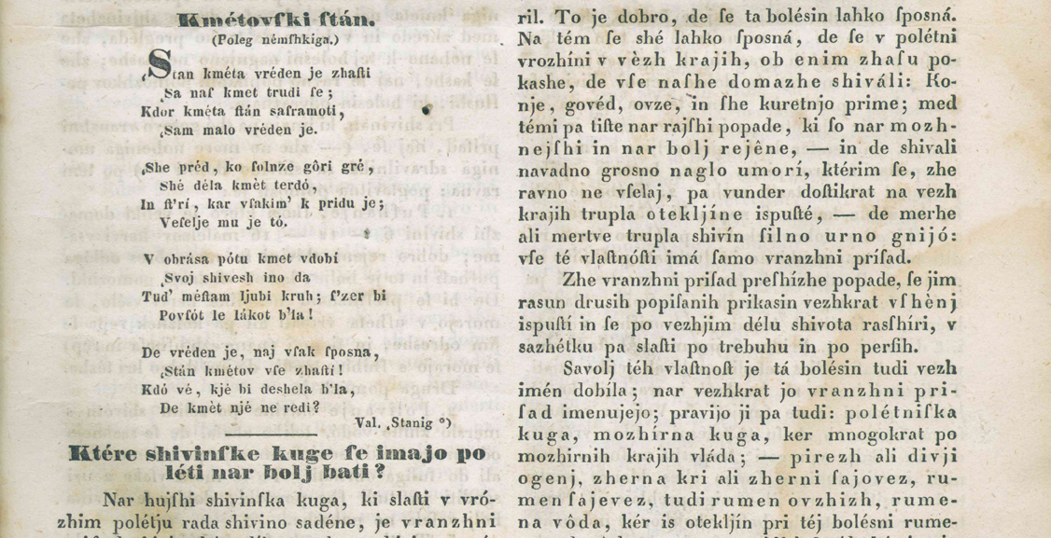
Example (Kmetijske in rokodelske novice)

Slide 6
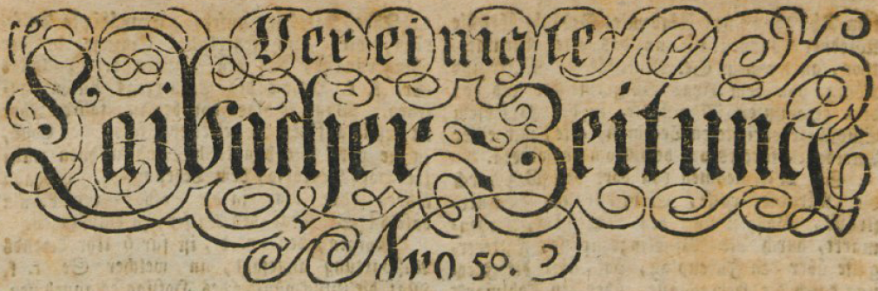
Example (Laibacher Zeitung)
JPEG 300dpi 24bit color
Digitization by issue
PDF (text behind image)
Metadata in simplified DCXML (pre-prepared)
Complicated OCR (TXT & HTML)
Notes:
PDFs are resized for web deployment

Slide 7
Example (Laibacher Zeitung)
<?xml version="1.0" encoding="windows-1250" ?>
<stevilka>
<title>Laibacher Zeitung</title>
<date>02.01.1904</date>
<type>tekstovno gradivo - serijska publikacija</type>
<format>št. 01, 6 strani</format>
<source>Laibacher Zeitung</source>
<language>ger</language>
<relation>1904-01-02_01.pdf</relation>
<id>NUK0059350</id>
<scans>1904-01-02_01-001.jpg</scans>
<scans>1904-01-02_01-002.jpg</scans>
<scans>1904-01-02_01-003.jpg</scans>
<scans>1904-01-02_01-004.jpg</scans>
<scans>1904-01-02_01-005.jpg</scans>
<scans>1904-01-02_01-006.jpg</scans>
</stevilka>

Slide 8
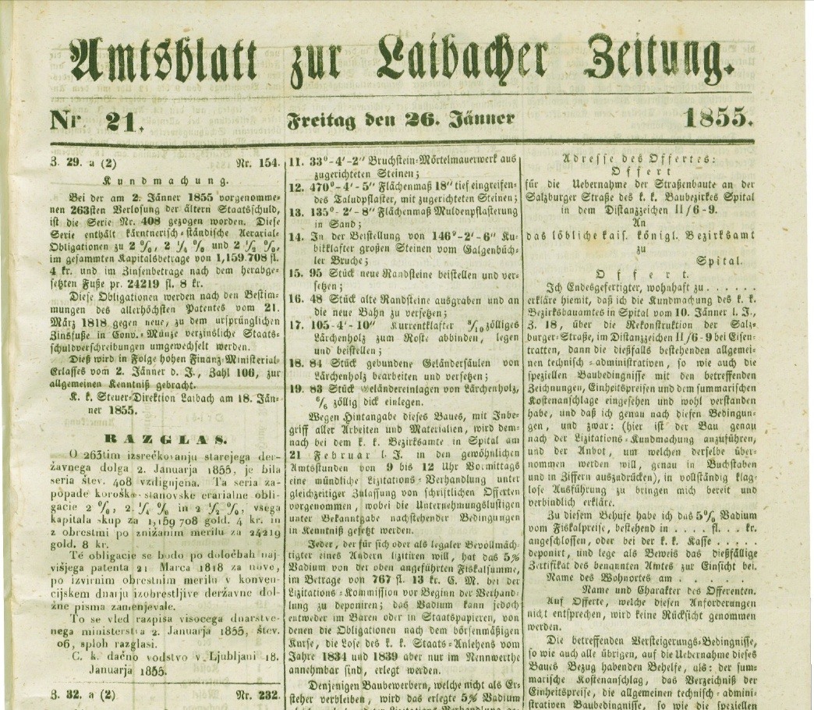
Example (Laibacher Zeitung)

Slide 9
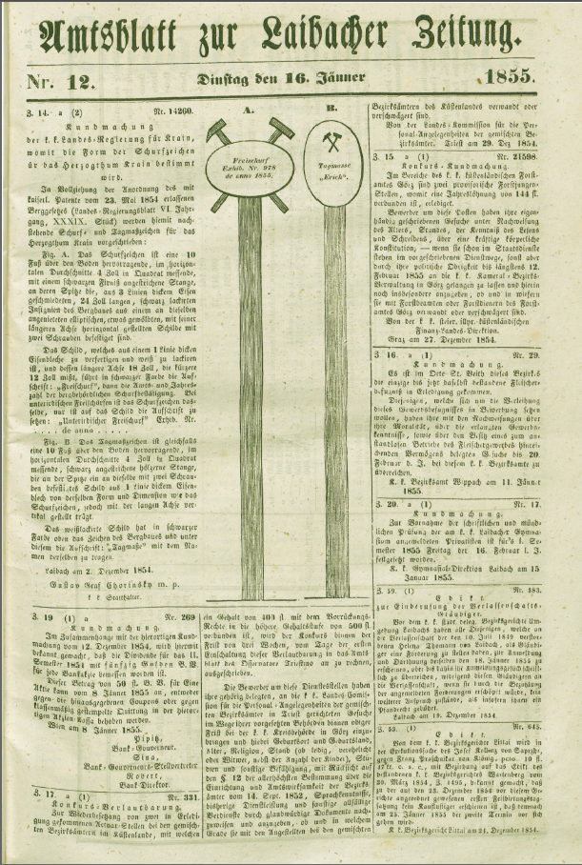
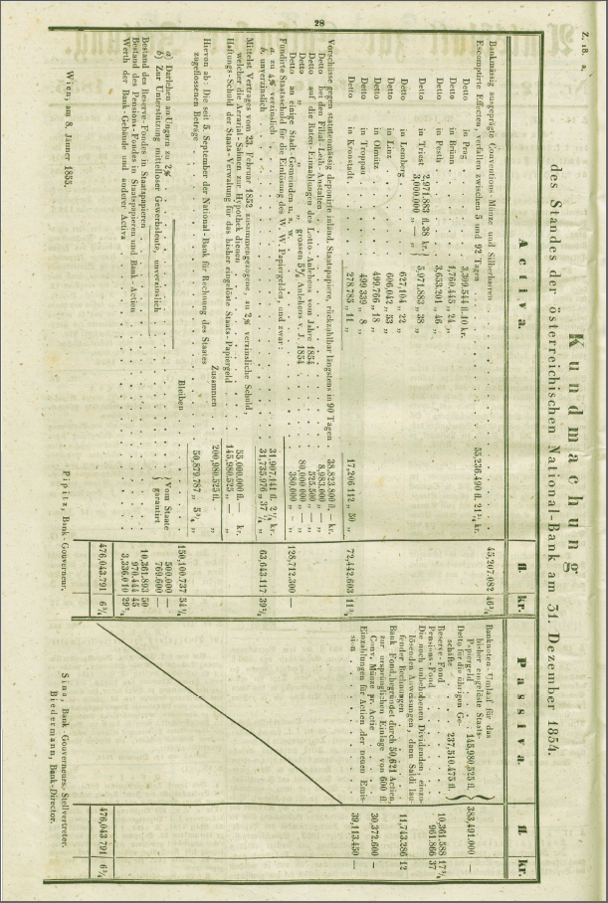
Example (Laibacher Zeitung)

Slide 10

Example (Jutro – microfilm)
JPEG 4200dpi grayscale
Digitization by issue
PDF (text behind image)
Metadata in simplified DCXML (pre-prepared)
Notes:
4200dpi on 35x24mm film is equial to 300dpi on A2

Slide 11
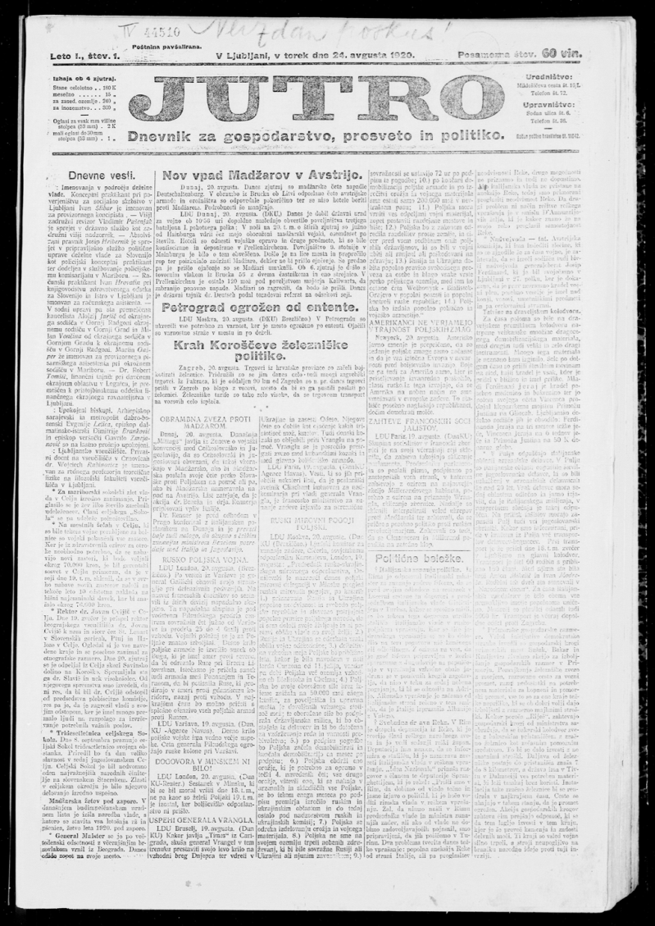
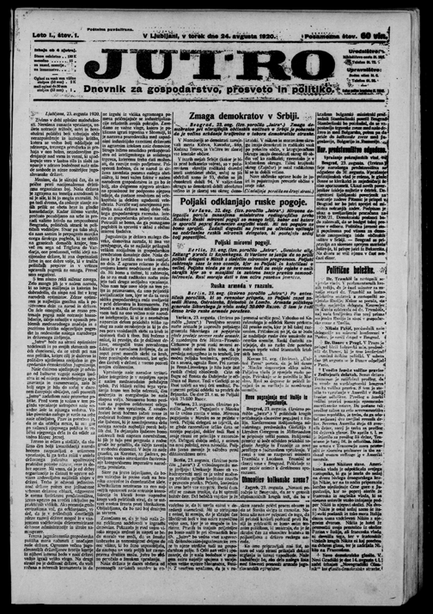
Example (Jutro – microfilm)

Slide 12
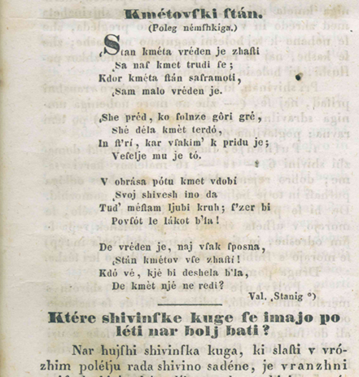
OCR problems
KmetovfliJl ftam
(Poleg nemfhkiga.)
<K?tan kmeta vreden je zhafti
4Sa naf kmet trudi fe ;
Kdor kmeta ffcin saframoti,
• tSam malo vreden je.
tShe pred, ko folnze gori gre ,
She dela kmet terdo,
In ft'ri, kar v takim' k pridu je;
Vefelje mu je to.
t V obrasa potu kmet vdobi
tSvoj shivesh ino da
Tud^ meftam ljubi kruli; Pzer bi
Povfot le lakot b'ia!
De vreden je, naj vfak fposna,
tStan kmetov vfe zhafti!
Kdo ve, kje bi deshela b'la,
De kmet nje ne redi?
____________ Val. .Stanig *)
Notes:
Zooning – takes a lot of time and effort
OCR mistakes
Quality of scan (quality control doesn’t pay off)
Language tools can play substantial role
Software
IMPACT project
Manual correction (experts, users) – Australian model

Slide 13


National and University Library
mojca.savnik@nuk.uni-lj.si
tine.musek@nuk.uni-lj.si
MFC.2 d.o.o.
sasa.bazdar@mfc-2.si

